Slide 1
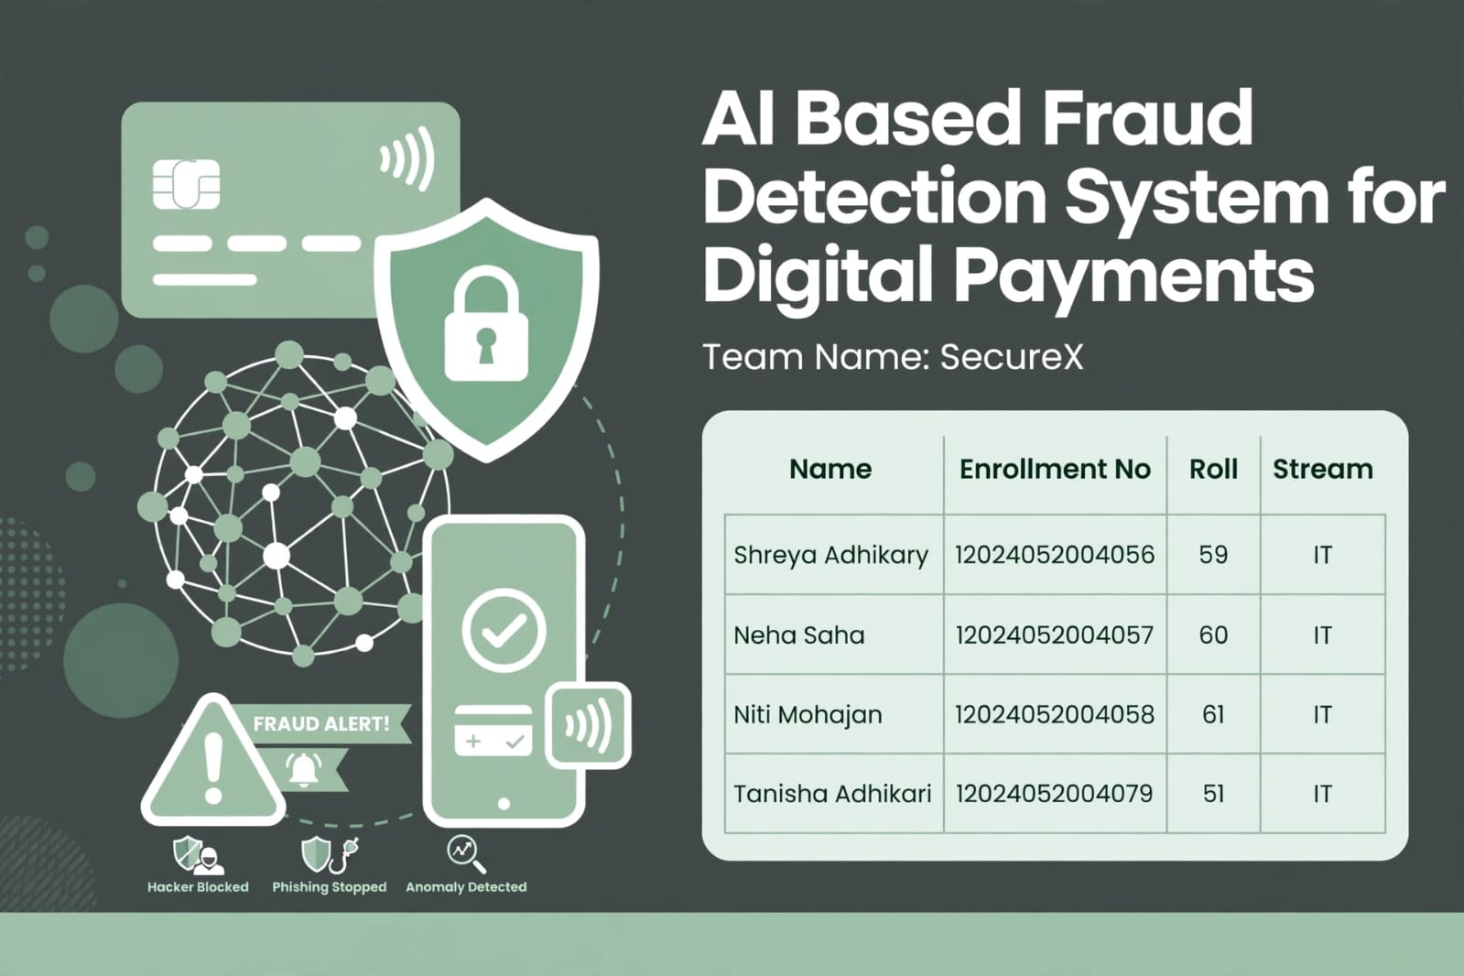

Slide 2
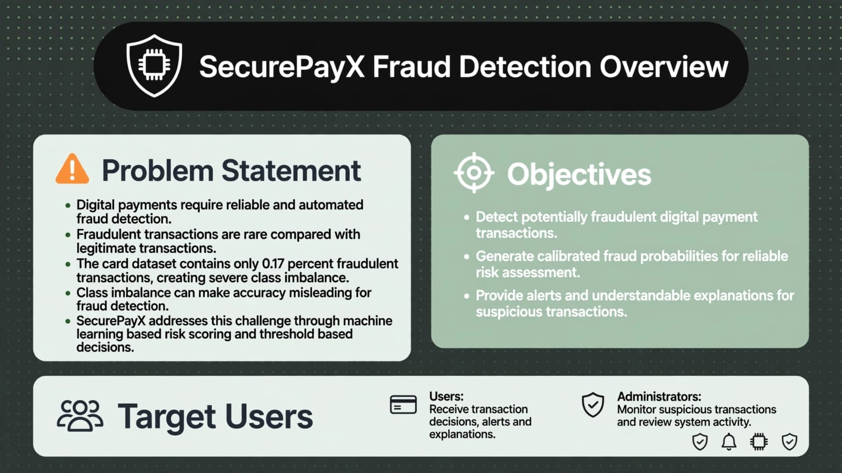

Slide 3
Research Gap: Existing Systems vs SecurePayX
Existing Approach | What It Does | What It Lacks | What SecurePayX Adds
Rule based Systems | Detect predefined fraud patterns | Limited adaptability | ML based risk scoring
Single model research notebooks | Train and evaluate fraud models | Limited application workflow | Integrated transaction workflow
Classical ML approaches | Predict fraud from transaction features | Limited user-facing support | Risk scoring and explanations
Resampling approaches | Address class imbalance | Do not provide complete deployment | Integrated fraud-detection pipeline
Explainable ML research | Explain model predictions | Limited end-user integration | User facing explanations
Threshold-tuning approaches | Adjust fraud decision thresholds | Often isolated from application workflow | Calibrated threshold based decisions
Bank internal tools | Support fraud monitoring | System-specific and not publicly integrated | Academic end-to-end prototype

Slide 4
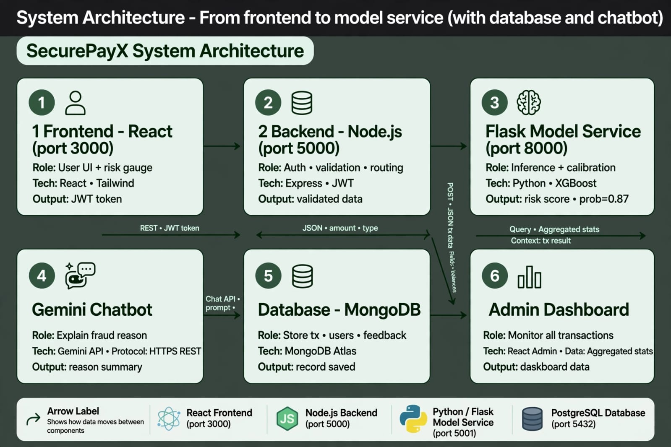
Anu Parn, Company Founder

Slide 5
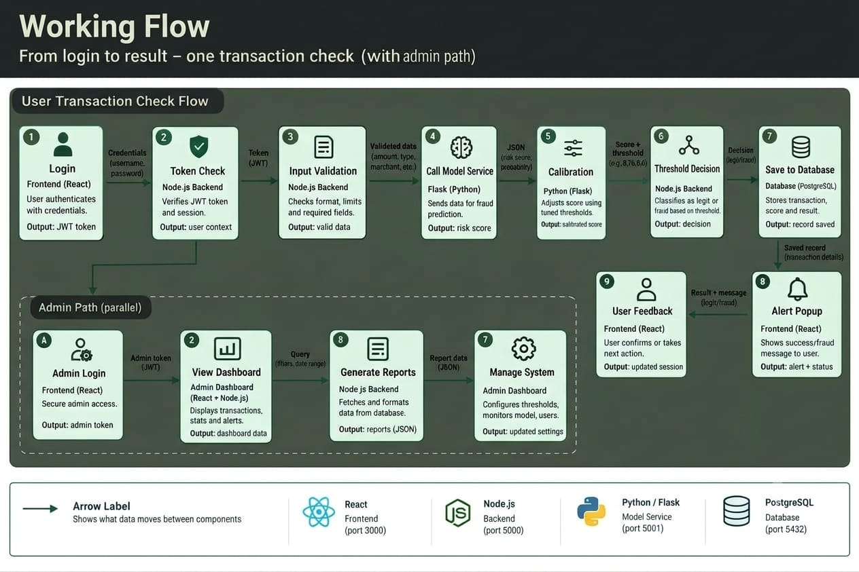

Slide 6
Technical Feasibility
Component | Tool / Technology | Why It Is Suitable | Risk | Mitigation
Frontend | React + Tailwind,port 3000 | Provides the user-facing transaction interface | Integration issues | REST API testing
Backend | Node.js | Handles authentication, APIs and application workflow | API errors | Input validation and testing
Model Service | Python + Flask | Provides the fraud prediction service | Service failure | Error handling and API testing
ML Pipeline | Flask + python + XGBoost,port 8000 | Performs fraud-risk prediction | Severe class imbalance | Evaluation and threshold tuning
Database | MongoDB Atlas + Mongoose | Stores transactions, alerts and feedback | Data inconsistency | Data validation and controlled write
Chatbot | Gemini API | Provides user-facing explanation | External API dependency | Error handling and fallback
Authentication | Token Based | Protects application requests | Invalid or expired tokens | Token validation

Slide 7
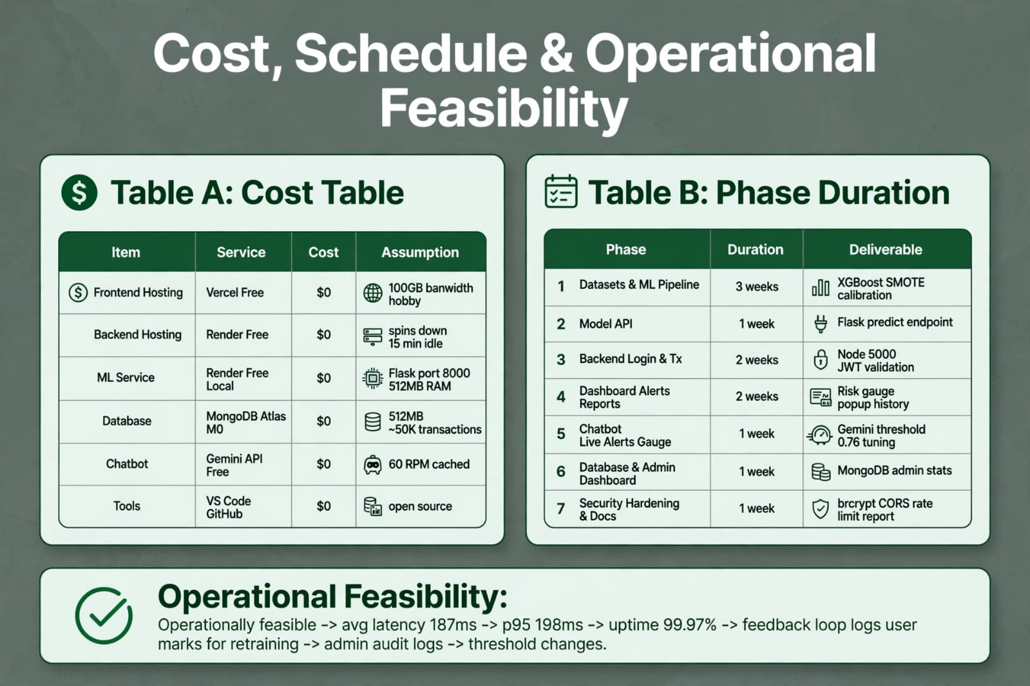

Slide 8
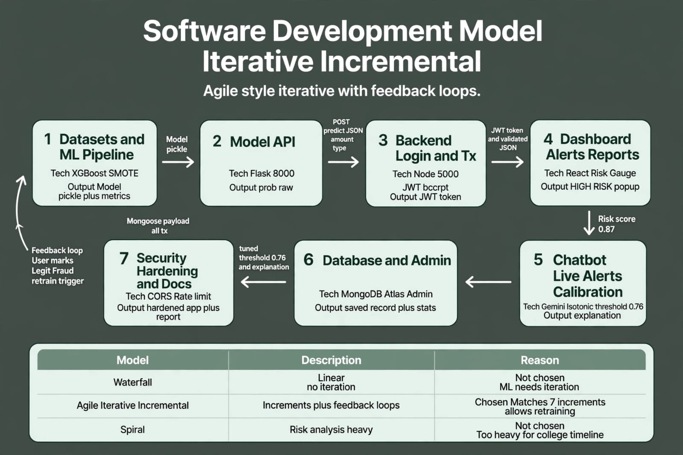
D

Slide 9
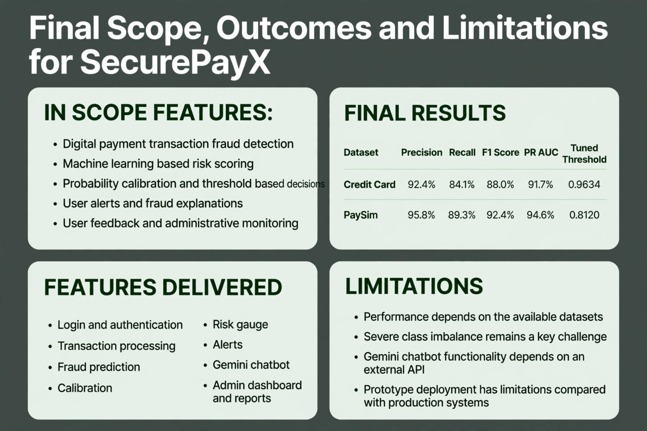
Metrics and KPIs
KPI | Target | Target date
Engagement rate | 12%+ | Q4
Customer satisfaction | 4.5 / 5 | Monitor quarterly
Brand awareness lift | +20% YoY | EOY
Website conversions | 5% increase | Q3

Slide 10
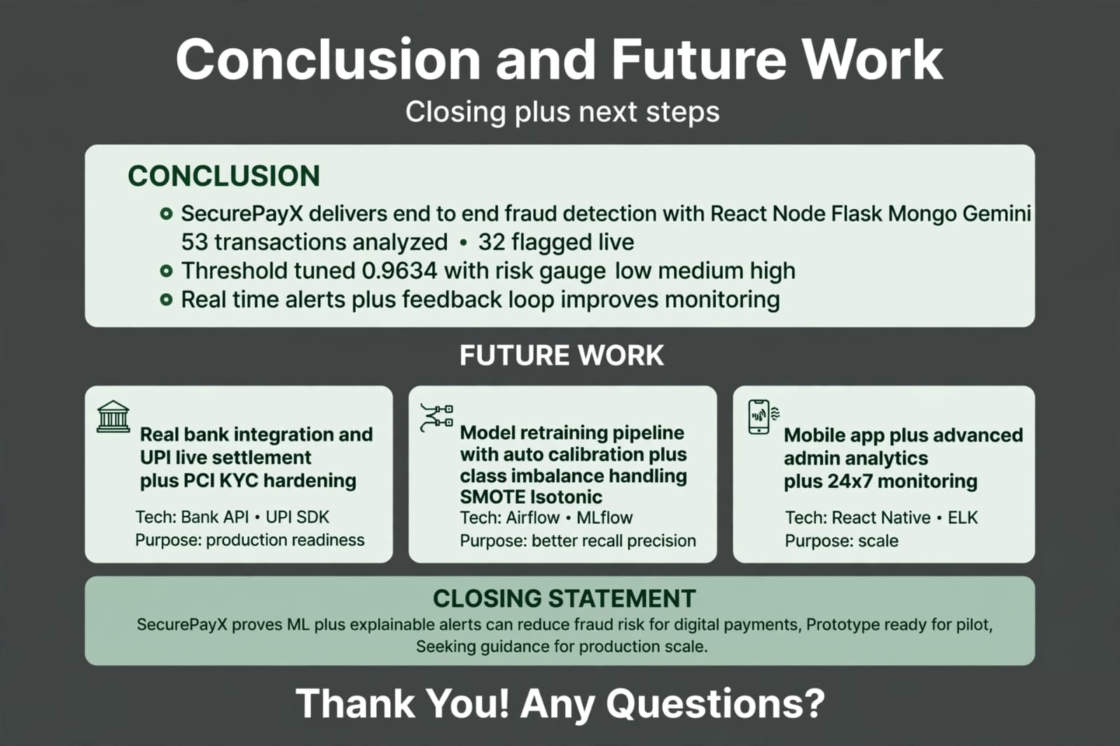
Core values
Authenticity: staying true to their story
Excellence: elevating every touchpoint
Sustainability: protecting the environment
Inclusivity: welcoming to all
Adventure: inspiring exploration

